Slide 1






String-inspired Cosmologies with Anomalies: Inflation, primordial black holes & Gravitational Waves
Nick E. Mavromatos
Natl. Tech. U. Athens, Greece
&
King’s College London, UK
CA18108 - Quantum gravity phenomenology in the multi-messenger approach

Slide 2


0. Outline

Slide 3
Motivation
Running Vacuum Model (RVM) of Cosmology & inflation without external inflatons
String-Inspired Gravitational Theory with Torsion & Grav. Anomalies, axions and torsion
Primordial Gravitational Waves (GW) induced Condensates of Anomalies, the role of supersymmetry
Spontaneous Lorentz and CPT-Violation by axion backgrounds & RVM inflation
Enhanced cosmic perturbations & densities of primordial black holes (PBH) & GW → dark matter components: PBH, together with the torsion-induced axions
Post Inflationary eras & cosmic evolution of the stringy RVM:
Spontaneous Lorentz and CPT-Violation by axion backgrounds & Leptogenesis
in radiation era → Baryogenesis ;
Modern-era phenomenology: deviations from ΛCDM and alleviation of cosmological
data tensions?
8. Summary

Slide 4
This talk
Motivation
Running Vacuum Model (RVM) of Cosmology & inflation without external inflatons
String-Inspired Gravitational Theory with Torsion & Grav. Anomalies, axions and torsion
Primordial Gravitational Waves (GW) induced Condensates of Anomalies, the role of supersymmetry
Spontaneous Lorentz and CPT-Violation by axion backgrounds & RVM inflation
Enhanced cosmic perturbations & densities of primordial black holes (PBH) & GW → dark matter components: PBH, together with the torsion-induced axions
Post Inflationary eras & cosmic evolution of the stringy RVM:
Spontaneous Lorentz and CPT-Violation by axion backgrounds & Leptogenesis
in radiation era → Baryogenesis ;
Modern-era phenomenology: deviations from ΛCDM and alleviation of cosmological
data tensions?
8. Summary

Slide 5

This talk
Motivation
Running Vacuum Model (RVM) of Cosmology & inflation without external inflatons
String-Inspired Gravitational Theory with Torsion & Grav. Anomalies, axions and torsion
Primordial Gravitational Waves (GW) induced Condensates of Anomalies, the role of supersymmetry
Spontaneous Lorentz and CPT-Violation by axion backgrounds & RVM inflation
Enhanced cosmic perturbations & densities of primordial black holes (PBH) & GW → dark matter components: PBH, together with the torsion-induced axions
Post Inflationary eras & cosmic evolution of the stringy RVM:
Spontaneous Lorentz and CPT-Violation by axion backgrounds & Leptogenesis
in radiation era → Baryogenesis ;
Modern-era phenomenology: deviations from ΛCDM and alleviation of cosmological
data tensions?
8. Summary
→ Production of primordial GW

Slide 6
This talk
Motivation
Running Vacuum Model (RVM) of Cosmology & inflation without external inflatons
String-Inspired Gravitational Theory with Torsion & Grav. Anomalies, axions and torsion
Primordial Gravitational Waves (GW) induced Condensates of Anomalies, the role of supersymmetry
Spontaneous Lorentz and CPT-Violation by axion backgrounds & RVM inflation
Enhanced cosmic perturbations & densities of primordial black holes (PBH) & GW → dark matter components: PBH, together with the torsion-induced axions
Post Inflationary eras & cosmic evolution of the stringy RVM:
Spontaneous Lorentz and CPT-Violation by axion backgrounds & Leptogenesis
in radiation era → Baryogenesis ;
Modern-era phenomenology: deviations from ΛCDM and alleviation of cosmological
data tensions?
8. Summary

Slide 7
1. Motivation

Slide 8
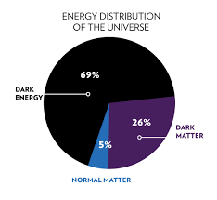

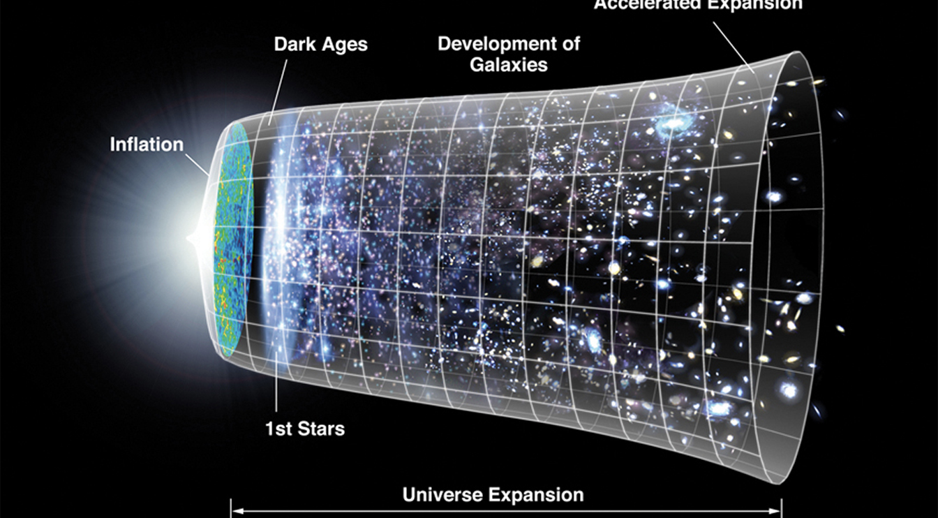
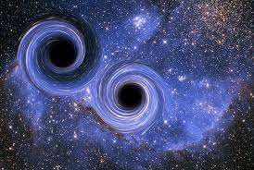
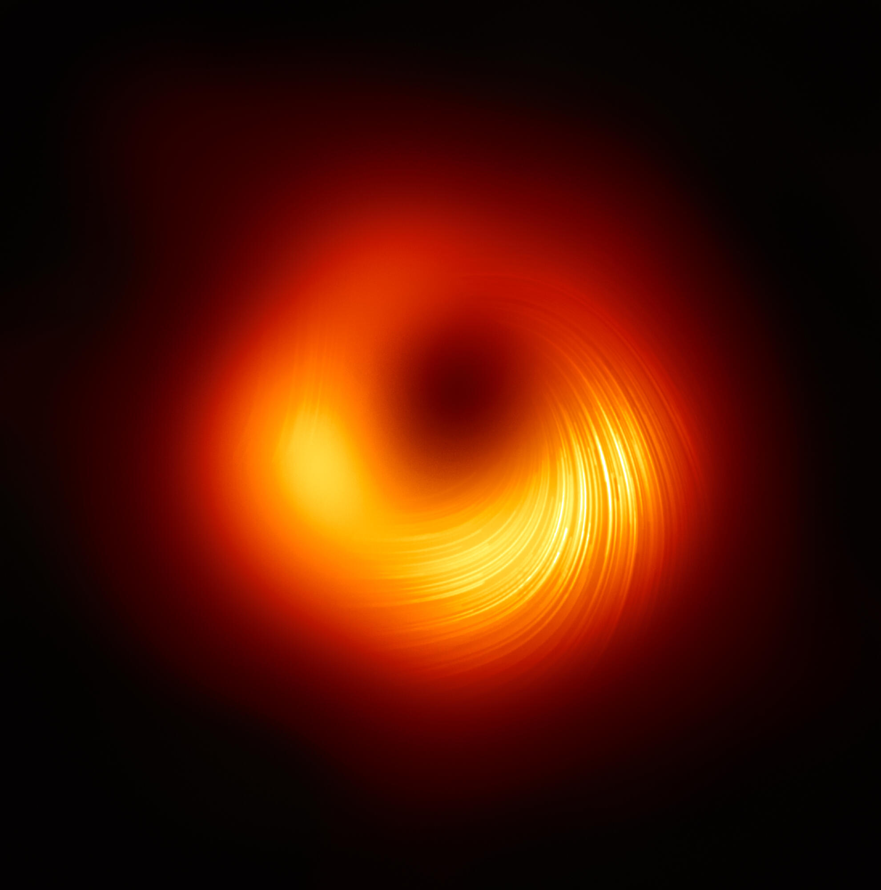

Important (> last 20 yrs) Discoveries in Cosmology/Astronomy
Planck2018 data
Simplest model based
on ΛCDM works OK
for large scales
+ SnIa, BaO, Lensing
Also Einstein’s GR explains
sufficiently well
Black-Hole Mergers + GW
(since 2015 LIGO),
Black-Hole `photographs’ (EHT),...

Slide 9


Important (> last 20 yrs) Discoveries in Cosmology/Astronomy
Planck2018 data
Simplest model based
on ΛCDM works OK
for large scales
But....
What still we do not know/did not observe:
Nature of Dark Energy
Nature of Dark matter
Primordial Gravitational Waves
(through detection of B-mode polarisation
in CMB from very early Universe)
Microscopic models of Inflation
(Is it due to fundamental inflatons or dynamical e.g. Starobinsky type? ....)
Need to go
Beyond....
Planck 2018 Inflation
+ SnIa, BaO, Lensing
Also Einstein’s GR explains
sufficiently well
Black-Hole Mergers + GW
(since 2015 LIGO),
Black-Hole `photographs’ (ET),...

Slide 10

Important (> last 20 yrs) Discoveries in Cosmology/Astronomy
Planck2018 data
ΛCDM appears
to be in tension with local measurements of present-era H₀
& also σ₈ galaxy-growth data ?
Simplest model based
on ΛCDM works OK
for large scales
But....
What still we do not know/did not observe:
Nature of Dark Energy
Nature of Dark matter
Primordial Gravitational Waves
(through detection of B-mode polarisation
in CMB from very early Universe)
Microscopic models of Inflation
(Is it due to fundamental inflatons or dynamical e.g. Starobinsky type? ....)
Need to go
Beyond....
Planck 2018 Inflation
Planck 2018 Inflation
Planck 2018 Inflation
+ SnIa, BaO, Lensing
Also Einstein’s GR explains
sufficiently well
Black-Hole Mergers + GW
(since 2015 LIGO),
Black-Hole `photographs’ (ET),...

Slide 11
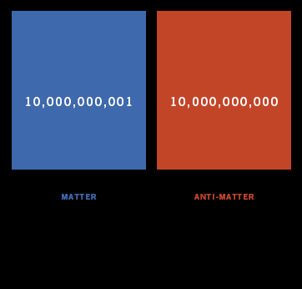
Microscopic
understanding of
Matter/Antimatter
asymmetry in the
Universe?
Baryon density in the Universe:
From CMB (Planck 2018 data)
Ω_{b} h²=0.0224±0.0001
From Big Bang Nucleosynthesis
Ω_{b} h²=0.0214±0.002
Baryon vs anti-baryon densities The Baryon Asymmetry
T > 1 GeV
s = entropy density
of Universe

Slide 12
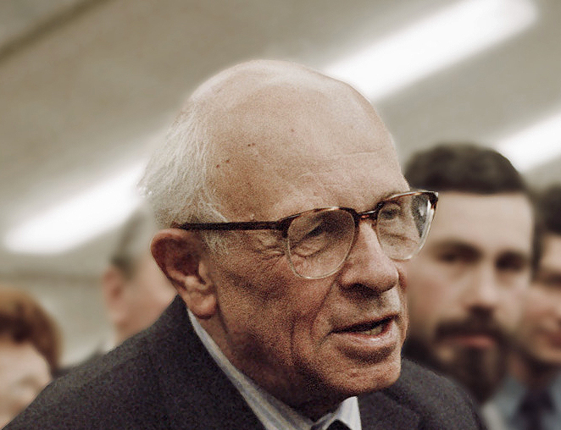

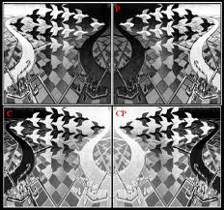
Attempts at Explanation of Baryon Asymmetry
– Sakharov ‘s Conditions
Baryon number violation
C-violation
and CP violation
Departure from thermodynamic equilibrium (non-stationary system)
CPT conservation
assumed
Need to go
Beyond....
CP |particle> = |anti-particle>
Need new physics beyond the SM →
new sources of CP violation?

Slide 13
Attempts at Explanation of Baryon Asymmetry
– Sakharov ‘s Conditions
Baryon number violation
C-violation
and CP violation
Departure from thermodynamic equilibrium (non-stationary system)
What if CPTV geometries
in the early Universe ?
CPT conservation
assumed
Need to go
Beyond....
CP |particle> = |anti-particle>
Need new physics beyond the SM →
new sources of CP violation?

Slide 14
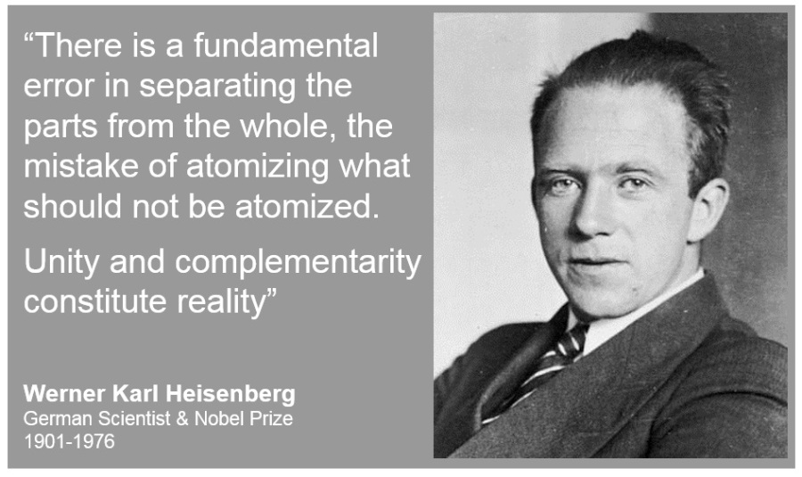

Overview
The Parts & the Whole

Slide 15
I will argue that:
Deviations from ΛCDM and alleviation of cosmological-data
Tensions in the current era
+
observed matter-antimatter asymmetry
Can be linked with
Microscopic string-inspired models of Cosmology with ANOMALIES,
primordial gravitational waves (GW) and induced spontaneous
(through gravitational anomaly condensates) Lorentz + CPT Violation
+
geometric torsion interpretation of axion Dark matter
Enhanced gravitational pertubations (Primordial Black Boles, GW)

Slide 16
I will argue that:
Deviations from ΛCDM and alleviation of cosmological-data
Tensions in the current era
+
observed matter-antimatter asymmetry
Can be linked with
Microscopic string-inspired models of Cosmology with ANOMALIES,
primordial gravitational waves (GW) and induced spontaneous
(through gravitational anomaly condensates) Lorentz + CPT Violation
+
geometric torsion interpretation of axion Dark matter
Enhanced gravitational pertubations (Primordial Black Boles, GW)

Slide 17

I will argue that:
Deviations from ΛCDM and alleviation of cosmological-data
Tensions in the current era
+
observed matter-antimatter asymmetry
Can be linked with
Microscopic string-inspired models of Cosmology with ANOMALIES,
primordial gravitational waves (GW) and induced spontaneous
(through gravitational anomaly condensates) Lorentz + CPT Violation
+
geometric torsion interpretation of axion Dark matter
Enhanced gravitational pertubations (Primordial Black Boles, GW)

Slide 18
I will argue that:
Deviations from ΛCDM and alleviation of cosmological-data
Tensions in the current era
+
observed matter-antimatter asymmetry
Can be linked with
Microscopic string-inspired models of Cosmology with ANOMALIES,
primordial gravitational waves (GW) and induced spontaneous
(through gravitational anomaly condensates) Lorentz + CPT Violation
+
geometric torsion interpretation of axion Dark matter
Enhanced gravitational pertubations (Primordial Black Boles, GW)
The Parts

Slide 19


I will argue that:
Deviations from ΛCDM and alleviation of cosmological-data
Tensions in the current era
+
observed matter-antimatter asymmetry
Can be linked with
Microscopic string-inspired models of Cosmology with ANOMALIES,
primordial gravitational waves (GW) and induced spontaneous
(through gravitational anomaly condensates) Lorentz + CPT Violation
+
geometric torsion interpretation of axion Dark matter
Enhanced gravitational pertubations (Primordial Black Boles, GW)
The Whole:
Stringy Running Vacuum
Model

Slide 20
I will argue that:
Deviations from ΛCDM and alleviation of cosmological-data
Tensions in the current era
+
observed matter-antimatter asymmetry
Can be linked with
Microscopic string-inspired models of Cosmology with ANOMALIES,
primordial gravitational waves (GW) and induced spontaneous
(through gravitational anomaly condensates) Lorentz + CPT Violation
+
geometric torsion interpretation of axion Dark matter
Enhanced gravitational pertubations (Primordial Black Boles, GW)
The Whole:
Stringy Running Vacuum
Model

Slide 21
Important Ingredients
The anomaly condensate
The stringy axion fields
The axions – condensate coupling

Slide 22
Important Ingredients
The anomaly condensate
The stringy axion fields
String-model
Independent
axion
Compactification
axion
The axions – condensate coupling

Slide 23
Important Ingredients
The anomaly condensate
The stringy axion fields
Lead to spontaneously violating Lorentz
(& CPT) symmetry axion backgrounds
The axions – condensate coupling

Slide 24
Important Ingredients
The anomaly condensate
The stringy axion fields
The axions – condensate coupling
Lead to Running Vacuum Model (RVM)
Inflation without external inflaton fields

Slide 25
2. Running-Vacuum Model
Cosmology –
Inflation
without external inflatons

Slide 26

The Parts
Dark Energy
(``running
vacuum model
(RVM) type’’)

Slide 27



The Parts
Shapiro + Solà
Solà, ...
Dark Energy
(``running
vacuum model
(RVM) type’’)
RVM
Λ
Vacuum energy density assumed de Sitter like but with time-dependent Cosmological
parameter Λ(t) :
Renormalization-Group-like equation for the evolution of vacuum energy density
Hubble parameter H(t) ←→ RG scale μ
general covariance →
even powers of H

Slide 28
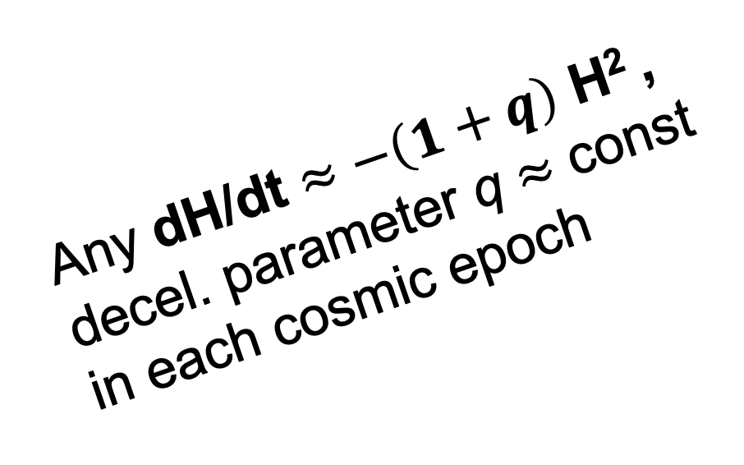
The Parts
Shapiro + Solà
Solà, ...
Dark Energy
(``running
vacuum model
(RVM) type’’)
RVM
Λ
Any dH/dt $≈−\left(1+q\right)$ H² ,
decel. parameter q $≈$ const
in each cosmic epoch
Vacuum energy density assumed de Sitter like but with time-dependent Cosmological
parameter Λ(t) :
Renormalization-Group-like equation for the evolution of vacuum energy density
Hubble parameter H(t) ←→ RG scale μ
general covariance →
even powers of H

Slide 29
The Parts
Shapiro + Solà
Solà, ... (> 2000)
Dark Energy
(``running
vacuum model
(RVM) type’’)
RVM
Λ
Vacuum energy density assumed de Sitter like but with time-dependent Cosmological
parameter Λ(t) :
Also: Ellis, NEM, Nanopoulos
(1998) – in non critical strings
Renormalization-Group-like equation for the evolution of vacuum energy density
Hubble parameter H(t) ←→ RG scale μ
general covariance →
even powers of H

Slide 30









Basilakos, Lima,
Sola + Gomez Valent
+ ... (2013 - 2018 )
Cosmological Evolution of RVM
m = matter, radiation
Solution
Early de Sitter
(unstable)
Radiation
Late dark-Energy
dominated era
c₀ dominant

Slide 31
Basilakos, Lima,
Sola + Gomez Valent
+ ... (2013 - 2018 )
Cosmological Evolution of RVM
m = matter, radiation
Solution
without
fundamental
inflatons
Early de Sitter
(unstable)
Radiation
Late dark-Energy
dominated era
c₀ dominant

Slide 32
Basilakos, Lima,
Sola + Gomez Valent
+ ... (2013 - 2018 )
Cosmological Evolution of RVM
m = matter, radiation
Solution
Early de Sitter
(unstable)
Radiation
Late dark-Energy
dominated era
c₀ dominant

Slide 33



`
Gómez-Valent, Sola
Could
Alleviate
Tensions in
Data, e.g.
H₀ , σ₈
tensions
0 <
0
β
₀
_
₀
0
M⁴_{Pl}

Slide 34
`
Gómez-Valent, Sola
Could
Alleviate
Tensions in
Data, e.g.
H₀ , σ₈
tensions
0 <
0
β
₀
_
₀
0
M⁴_{Pl}
Not dominant today

Slide 35

`
Gómez-Valent, Sola
Could
Alleviate
Tensions in
Data, e.g.
H₀ , σ₈
tensions
0 <
0
β
₀
_
₀
0
M⁴_{Pl}
Not dominant today
Running RVM
Dark Energy

Slide 36
Solà, Gómez-Valent,
De Cruz Perez, Moreno-Pulido,
(Planck 2018 data)
Session
talks
Alleviation of the H₀ , σ₈ tension by RVM model

Slide 37
Solà, Gómez-Valent,
De Cruz Perez, Moreno-Pulido,
(Planck 2018 data)
Session
talks
Alleviation of the H₀ , σ₈ tension by RVM model
Mild lnH dependences

Slide 38
The Parts
Shapiro + Solà
Solà, ...
Dark Energy
(``running
vacuum model
(RVM) type’’)
RVM
Λ
This talk:
We shall obtain
an (type II) RVM from
Grav. Anomalies
in string-inspired
Cosmology
Vacuum energy density assumed de Sitter like but with time-dependent Cosmological
parameter Λ(t) :
NEM, Solà
+ Basilakos
Renormalization-Group-like equation for the evolution of vacuum energy density
Hubble parameter H(t) ←→ RG scale μ
general covariance →
even powers of H

Slide 39
3. String-Inspired Gravitational
Theory with
Torsion & Grav. Anomalies,
axions and torsion

Slide 40
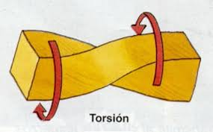
The Parts
Dark Energy
(``running
vacuum model
(RVM) type’’)
Stringy
gravitational
Axions
+
torsion

Slide 41
Gross and Sloan, Metsaev and Tseytlin
Massless Gravitational
multiplet of (closed) strings:
spin 0 scalar (dilaton Φ)
spin 2 traceless symmetric rank 2
tensor (graviton g_{μν})
spin 1 antisymmetric rank 2 tensor
Stringy
gravitational
Axions
+
torsion
KALB-RAMOND FIELD

Slide 42
Gross and Sloan, Metsaev and Tseytlin
Massless Gravitational
multiplet of (closed) strings:
spin 0 scalar (dilaton Φ)
spin 2 traceless symmetric rank 2
tensor (graviton g_{μν})
spin 1 antisymmetric rank 2 tensor
Stringy
gravitational
Axions
+
torsion
KALB-RAMOND FIELD

Slide 43
Gross and Sloan, Metsaev and Tseytlin
Massless Gravitational
multiplet of (closed) strings:
spin 0 scalar (dilaton Φ)
spin 2 traceless symmetric rank 2
tensor (graviton g_{μν})
spin 1 antisymmetric rank 2 tensor
Stringy
gravitational
Axions
+
torsion
KALB-RAMOND FIELD

Slide 44
Gross and Sloan, Metsaev and Tseytlin
Massless Gravitational
multiplet of (closed) strings:
spin 0 scalar (dilaton Φ)
spin 2 traceless symmetric rank 2
tensor (graviton g_{μν})
spin 1 antisymmetric rank 2 tensor
Stringy
gravitational
Axions
+
torsion
KALB-RAMOND FIELD
4-DIM
action
κ² = 8π G

Slide 45
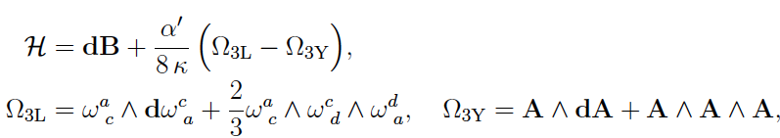

Gross and Sloan, Metsaev and Tseytlin
Massless Gravitational
multiplet of (closed) strings:
spin 0 scalar (dilaton Φ)
spin 2 traceless symmetric rank 2
tensor (graviton g_{μν})
spin 1 antisymmetric rank 2 tensor
Stringy
gravitational
Axions
+
torsion
KALB-RAMOND FIELD
4-DIM
action
κ² = 8π G
Green, Schwarz
String Anomaly Cancellation requires modification in definition of H_{μνρ}
H

Slide 46
Gross and Sloan, Metsaev and Tseytlin
Massless Gravitational
multiplet of (closed) strings:
spin 0 scalar (dilaton Φ)
spin 2 traceless symmetric rank 2
tensor (graviton g_{μν})
spin 1 antisymmetric rank 2 tensor
Stringy
gravitational
Axions
+
torsion
KALB-RAMOND FIELD
4-DIM
action
κ² = 8π G
Green, Schwarz
String Anomaly Cancellation requires modification in definition of H_{μνρ}
H

Slide 47


Gross and Sloan, Metsaev and Tseytlin
Massless Gravitational
multiplet of (closed) strings:
spin 0 scalar (dilaton Φ)
spin 2 traceless symmetric rank 2
tensor (graviton g_{μν})
spin 1 antisymmetric rank 2 tensor
Stringy
gravitational
Axions
+
torsion
KALB-RAMOND FIELD
4-DIM
action
Φ = constant
throughout
generalised
curvature
Contorsion

Slide 48
Gross and Sloan, Metsaev and Tseytlin
Massless Gravitational
multiplet of (closed) strings:
spin 0 scalar (dilaton Φ)
spin 2 traceless symmetric rank 2
tensor (graviton g_{μν})
spin 1 antisymmetric rank 2 tensor
Stringy
gravitational
Axions
+
torsion
KALB-RAMOND FIELD
4-DIM
action
Φ = constant
throughout
generalised
curvature
Contorsion

Slide 49
Gross and Sloan, Metsaev and Tseytlin
Massless Gravitational
multiplet of (closed) strings:
spin 0 scalar (dilaton Φ)
spin 2 traceless symmetric rank 2
tensor (graviton g_{μν})
spin 1 antisymmetric rank 2 tensor
Stringy
gravitational
Axions
+
torsion
KALB-RAMOND FIELD
4-DIM
action
No tree-level Cosmological Constant
(otherwise scattering matrix would not be defined
in perturbative strings)
Φ = constant
throughout
generalised
curvature
Contorsion

Slide 50
Gross and Sloan, Metsaev and Tseytlin
Massless Gravitational
multiplet of (closed) strings:
spin 0 scalar (dilaton Φ)
spin 2 traceless symmetric rank 2
tensor (graviton g_{μν})
spin 1 antisymmetric rank 2 tensor
Stringy
gravitational
Axions
+
torsion
KALB-RAMOND FIELD
4-DIM
action
quantum
torsion →
gravitational
axion b
``dual’’ to
H torsion
b(x) = Lagrange multiplier
implementing
Bianchi identity constraint for H_{μνρ} :
generalised
curvature
Contorsion

Slide 51



Inclusion of Fermions
or Majorana
vielbeins
KR-axion anomalous
CP-Violating interaction
Axial Current
All fermion species
torsion
cf. classically in 4 dim:

Slide 52
Inclusion of Fermions
or Majorana
vielbeins
4-fermion contact interaction
characteristic of
(integrating out) torsion
Axial Current
Vanishes for Friedmann-Lemaitre-
Roberston-Walker backgrounds
torsion
cf. classically in 4 dim:
(duality relationship)

Slide 53
Inclusion of Fermions
or Majorana
vielbeins
4-fermion contact interaction
characteristic of
(integrating out) torsion
Axial Current
Vanishes for Friedmann-Lemaitre-
Roberston-Walker backgrounds
Kalb-Ramond (KR) or string-model
independent (``gravitational’’) axion
torsion
cf. classically in 4 dim:
(duality relationship)

Slide 54
The Model
or Majorana
All fermion species

Slide 55
The Model
Anomaly terms
or Majorana
All fermion species

Slide 56

The Parts
Dark Energy
(``running
vacuum model
(RVM) type’’)
Gravitational
anomalies
Stringy
gravitational
Axions
+
torsion

Slide 57
or gravitons

Slide 58
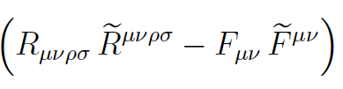

Gravitational Anomalies & Diffeomorphism Invariance
Gravitational
anomalies
Spoils conservation
of stress tensor
(diffeomorphism
invariance affected
in quantum theory)
Topological,
does NOT
contribute to
stress tensor
Cotton tensor
Traceless
Jackiw, Pi (2003)

Slide 59

Gravitational Anomalies & Diffeomorphism Invariance
Gravitational
anomalies
Spoils conservation
of stress tensor
(diffeomorphism
invariance affected
in quantum theory)
Topological,
does NOT
contribute to
stress tensor
Cotton tensor
not necessarily
positive
contributions
to vacuum energy
Traceless

Slide 60
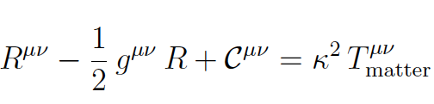
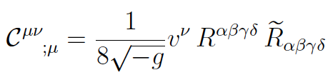

Gravitational Anomalies & Diffeomorphism Invariance
Einstein’s equation
-
-
8
= -
Diffeomoprphism
invariance breaking by
gravitational anomalies?

Slide 61

Gravitational Anomalies & Diffeomorphism Invariance
Einstein’s equation
-
-
8
No problem
with diffeo
Conserved Modified
stress-energy
tensor
+
=

Slide 62
Gravitational Anomalies & Diffeomorphism Invariance
Einstein’s equation
-
-
8
Exchange of energy
Between axions and
Gravitational (anomaly) sector
No problem
with diffeo
Conserved Modified
stress-energy
tensor
+
=

Slide 63
4. Primordial Gravitational
Waves, Anomaly condensates
– The role of
Supersymmetry

Slide 64
The Parts
Dark Energy
(``running
vacuum model
(RVM) type’’)
Gravitational
anomalies
Stringy
gravitational
Axions
+
torsion
Primordial
gravitational
waves

Slide 65
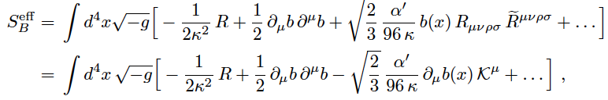
The Model in Early Universe:
only gravitational d.o.f. (b, g_{μν} )
Basilakos, NEM,
Sola (2019-20)
`

Slide 66

The Model in Early Universe:
only gravitational d.o.f. (b, g_{μν} )
Basilakos, NEM,
Sola (2019-20)
`
NB:
absent before
formation of GW
No potential for KR axion before generation of GW
stiff-matter, equation of state w=+1
stiff-axion-matter dominance
during very early (pre-inflationary) Universe

Slide 67
The Model in Early Universe:
only gravitational d.o.f. (b, g_{μν} )
Basilakos, NEM,
Sola (2019-20)
`
NB:
absent before
formation of GW
No potential for KR axion before generation of GW
stiff-matter, equation of state w=+1
stiff-axion-matter dominance
during very early (pre-inflationary) Universe
c.f. Zeldovich
but for baryons
in his model;
cf. also Chavanis

Slide 68
The Model in Early Universe:
only gravitational d.o.f. (b, g_{μν} )
Basilakos, NEM,
Sola (2019-20)
`
`
Primordial Gravitational Waves
Potential Origins in pre-inflationary era?
NEM,Sola
EPJ-ST (2020)

Slide 69
The Model in Early Universe:
only gravitational d.o.f. (b, g_{μν,} ψ_{μ} )
Basilakos, NEM,
Sola (2019-20)
`
`
Primordial Gravitational Waves
Potential Origins in pre-inflationary era?
Collapse/collisions of Domain walls formed in theories with (approximate) discrete symmetry breaking, e.g. via bias in double-well potentials of some condensate (gravitino ψ_{μ} or gaugino)
NEM,Sola
EPJ-ST (2020)

Slide 70
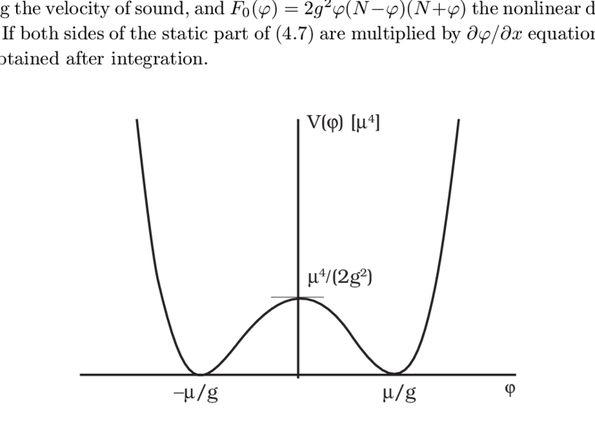
The Model in Early Universe:
only gravitational d.o.f. (b, g_{μν,} ψ_{μ} )
Basilakos, NEM,
Sola (2019-20)
`
V(σ)
Role of (Local)
Supersymmetry
_
+
0
V₀ >0
σ
`
Primordial Gravitational Waves
Potential Origins in pre-inflationary era?
Collapse/collisions of Domain walls formed in theories with (approximate) discrete symmetry breaking, e.g. via bias in double-well potentials of some condensate (gravitino ψ_{μ} or gaugino)
NEM,Sola
EPJ-ST (2020)
Ellis, NEM,
Alexandre,
Houston

Slide 71
The Model in Early Universe:
only gravitational d.o.f. (b, g_{μν,} ψ_{μ} )
Basilakos, NEM,
Sola (2019-20)
`
V(σ)
SUGRA broken
gravitino
Condensate
stabilised
Role of (Local)
Supersymmetry
_
+
0
V₀ >0
σ
`
Primordial Gravitational Waves
Potential Origins in pre-inflationary era?
Collapse/collisions of Domain walls formed in theories with (approximate) discrete symmetry breaking, e.g. via bias in double-well potentials of some condensate (gravitino ψ_{μ} or gaugino)
NEM,Sola
EPJ-ST (2020)
Ellis, NEM,
Alexandre,
Houston

Slide 72



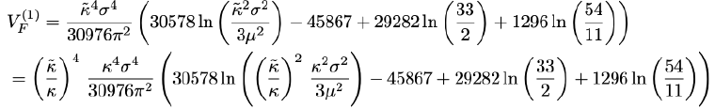
The Model in Early Universe:
only gravitational d.o.f. (b, g_{μν,} ψ_{μ} )
Basilakos, NEM,
Sola (2019-20)
`
V(σ)
SUGRA broken
gravitino
Condensate
stabilised
Role of (Local)
Supersymmetry
_
+
0
V₀ >0
σ
dilaton
λ = Goldstino
Ellis, NEM,
Alexandre,
Houston
μ = inverse RG scale

Slide 73
The Model in Early Universe:
only gravitational d.o.f. (b, g_{μν,} ψ_{μ} )
Basilakos, NEM,
Sola (2019-20)
`
V(σ)
SUGRA broken
gravitino
Condensate
stabilised
Role of (Local)
Supersymmetry
_
+
0
V₀ >0
`
Primordial Gravitational Waves
Potential Origins in pre-inflationary era?
Collapse/collisions of Domain walls formed in theories with (approximate) discrete symmetry breaking, e.g. via bias in double-well potentials of some condensate (gravitino ψ_{μ} or gaugino)
NEM,Sola
EPJ-ST (2020)
Ellis, NEM,
Alexandre,
Houston

Slide 74
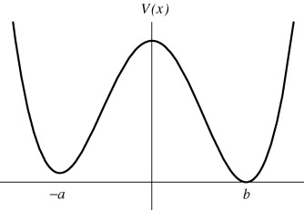
The Model in Early Universe:
only gravitational d.o.f. (b, g_{μν,} ψ_{μ} )
Basilakos, NEM,
Sola (2019-20)
`
V(σ)
SUGRA broken
gravitino
Condensate
stabilised →
RVM GW-induced Inflation
Role of (Local)
Supersymmetry
_
+
V₀ >0
0
σ
`
Primordial Gravitational Waves
Potential Origins in pre-inflationary era?
Collapse/collisions of Domain walls formed in theories with (approximate) discrete symmetry breaking, e.g. via bias in double-well potentials of some condensate (gravitino ψ_{μ} or gaugino)
NEM,Sola
EPJ-ST (2020)
Ellis, NEM,
Alexandre,
Houston

Slide 75
The Model in Early Universe:
only gravitational d.o.f. (b, g_{μν,} ψ_{μ} )
Basilakos, NEM,
Sola (2019-20)
`
V(σ)
SUGRA broken
gravitino
Condensate
stabilised →
RVM GW-induced Inflation
Role of (Local)
Supersymmetry
_
+
V₀ >0
0
σ
Lalak, Ovrut,
Lola, G. Ross,
Thomas
Statistical bias (percolation) in
occupation probabilities of the +,- vacua
`
Primordial Gravitational Waves
Potential Origins in pre-inflationary era?
Collapse/collisions of Domain walls formed in theories with (approximate) discrete symmetry breaking, e.g. via bias in double-well potentials of some condensate (gravitino ψ_{μ} or gaugino)
NEM,Sola
EPJ-ST (2020)
Ellis, NEM,
Alexandre,
Houston

Slide 76

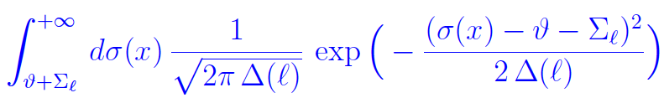
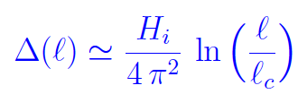

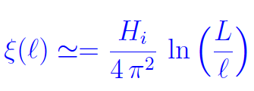

Primordial Gravitational Waves (GW)
Potential origins ?
NEM,Sola
EPJ-ST (2020)
L=radius of Universe
= radius of causal bubble
V(σ)
Not equal probabilities
for occupying + or – vacua
p⁺ ≠ p⁻ = 1 – p⁺
percolating unstable
domain walls → GW
_
Lalak, Ovrut,
Lola, G. Ross,
Thomas
+
σ

Slide 77
Primordial Gravitational Waves (GW)
Potential origins ?
NEM,Sola
EPJ-ST (2020)
L=radius of Universe
= radius of causal bubble
V(σ)
Hill-top
(first)
inflation
Not equal probabilities
for occupying + or – vacua
p⁺ ≠ p⁻ = 1 – p⁺
percolating unstable
domain walls → GW
_
Lalak, Ovrut,
Lola, G. Ross,
Thomas
+
σ

Slide 78


Primordial Gravitational Waves (GW)
Potential origins ?
NEM,Sola
EPJ-ST (2020)
V(σ)
Not equal probabilities
for occupying + or – vacua
p⁺ ≠ p⁻ = 1 – p⁺
percolating unstable
domain walls → GW
_
Lalak, Ovrut,
Lola, G. Ross,
Thomas
+
σ

Slide 79
The Model in Early Universe:
only gravitational d.o.f. (b, g_{μν,} ψ_{μ} )
V(σ)
SUGRA broken
gravitino
Condensate
stabilised →
RVM GW-induced Inflation
Role of (Local)
Supersymmetry
_
+
V₀ >0
0
σ
Potential bias of the +,- vacua:
Alternative scenarios
`
Primordial Gravitational Waves
Potential Origins in pre-inflationary era?
Collapse/collisions of Domain walls formed in theories with (approximate) discrete symmetry breaking, e.g. via bias in double-well potentials of some condensate (gravitino ψ_{μ} or gaugino)
NEM,Sola
EPJ-ST (2020)

Slide 80




Primordial Gravitational Waves (GW)
Potential origins ?
NEM,Sola
EPJ-ST (2020)
R-symmetry → Z_{2N} → Z₂ via
gaugino condensation in SU(N) gauge SUGRA models with SUSY broken in hidden sectors...
NB: Non-degenerate Scalar Potential
Z_{2N} → Z₂ → non-trivial energy shifts
between vacua create unstable Domain Walls → collide → GW
Takahashi,
Yanagida,
Yonekura
m_{3/2} = gravitino mass
m_{λ} = gaugino mass

Slide 81
The Model in Early Universe:
only gravitational d.o.f. (b, g_{μν,} ψ_{μ} )
Basilakos, NEM,
Sola (2019-20)
`
V(σ)
First hill-top
inflation
SUGRA broken
gravitino
Condensate
stabilised →
RVM GW-induced Inflation
_
+
V₀ >0
0
σ
Pre-RVM inflationary phase: superstring/supergravity
Effective action → Imaginary parts → instabilities
First Hill-top inflation = finite life –time →
System tunnels to RVM inflationary vacuum (GW condense)
`
NEM,Sola
EPJ-ST (2020)
Ellis, NEM,
Alexandre,
Houston

Slide 82
The Model in Early Universe:
only gravitational d.o.f. (b, g_{μν,} ψ_{μ} )
Basilakos, NEM,
Sola (2019-20)
`
V(σ)
First hill-top
inflation
SUGRA broken
gravitino
Condensate
stabilised →
RVM GW-induced Inflation
_
+
V₀ >0
0
σ
Pre-RVM inflationary phase: superstring/supergravity
Effective action → Imaginary parts → instabilities
First Hill-top inflation = finite life –time →
System tunnels to RVM inflationary vacuum (GW condense)
`
NEM,Sola
EPJ-ST (2020)
KR axion
dominance
?
GW + Anomalies
dominance
Ellis, NEM,
Alexandre,
Houston

Slide 83
The Model in Early Universe:
only gravitational d.o.f. (b, g_{μν,} ψ_{μ} )
Basilakos, NEM,
Sola (2019-20)
`
V(σ)
First hill-top
inflation
SUGRA broken
gravitino
Condensate
stabilised →
RVM GW-induced Inflation
_
+
V₀ >0
0
σ
Pre-RVM inflationary phase: superstring/supergravity
Effective action → Imaginary parts → instabilities
First Hill-top inflation = finite life –time →
System tunnels to RVM inflationary vacuum (GW condense)
First inflation ensures any
Spatial inhomogeneities
are washed out before
the RVM-GW inflation
`
NEM,Sola
EPJ-ST (2020)
KR axion
dominance
?
GW + Anomalies
dominance
Ellis, NEM,
Alexandre,
Houston

Slide 84
5. Spontaneous Lorentz &
CPT Violation
by axion backgrounds
and
RVM Inflation

Slide 85
The Parts
Dark Energy
(``running
vacuum model
(RVM) type’’)
Gravitational
anomalies
Stringy
gravitational
Axions
+
torsion
Primordial
gravitational
waves
Spontaneous
Lorentz + CPT
Violation
from
anomaly
condensates

Slide 86
The Model in Early Universe:
only gravitational d.o.f. (b, g_{μν} )
Basilakos, NEM,
Sola (2019-20)
`
Non-trivial if
GW present
Primordial Gravitational Waves,
&
De Sitter space times &
Spontaneous Lorentz & CPT Violation

Slide 87

The Model in Early Universe:
only gravitational d.o.f. (b, g_{μν} )
Basilakos, NEM,
Sola (2019-20)
`
Gravitational
Chern-Simons (gCS)
Primordial Gravitational Waves →
Condensate < ...> of Gravitational Anomalies
quantum ordered

Slide 88

The Model in Early Universe:
only gravitational d.o.f. (b, g_{μν} )
Basilakos, NEM,
Sola (2019-20)
`
Gravitational
Chern-Simons (gCS)
Cosmological-
Constant-like
Mild time
Dependence
(RVM) through H
Condensate < ...> of
Gravitational Anomalies
quantum ordered

Slide 89
The Model in Early Universe:
only gravitational d.o.f. (b, g_{μν} )
Basilakos, NEM,
Sola (2019-20)
`
Gravitational
Chern-Simons (gCS)
Cosmological-
``Constant’’-like
Mild time
Dependence
(RVM) through H
Condensate < ...> of
Gravitational Anomalies
Up to boundary terms

Slide 90

Effective action contains CP violating axion-like coupling
Assume de Sitter era, first, to discuss anomaly condensate
in the presence of GW perturbation
(ii) deduce RVM vacuum behaviour
and
(iii) Inflation is obtained self consistently from RVM evolution

Slide 91






Effective action contains CP violating axion-like coupling
Average
over inflationary
space time in the
presence of
primordial
Gravitational waves
b(x)=b(t)
Alexander, Peskin,
Sheikh -Jabbari
n* = proper number density of
sources of GW(assumed of O(1))
μ = UV k-momentum Cut-off
μ
n*
Homogeneity
& Isotropy
H ≈ const.
(inflation)

Slide 92
Effective action contains CP violating axion-like coupling
Average
over inflationary
space time in the
presence of
primordial
Gravitational waves
b(x)=b(t)
Alexander, Peskin,
Sheikh -Jabbari
n* = proper number density of
sources of GW(assumed of O(1))
μ = UV k-momentum Cut-off
μ
n*
Homogeneity
& Isotropy
H ≈ const.
(inflation)

Slide 93


Solutions (backgrounds) to the Eqs of Motion
n* = proper number density of
sources of GW(assumed of O(1))
μ
n*
time evolution of Anomaly
μ = UV k-momentum Cut-off
M_{s}

Slide 94
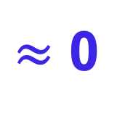
Solutions (backgrounds) to the Eqs of Motion
n* = proper number density of
sources of GW(assumed of O(1))
μ
n*
time evolution of Anomaly
μ = UV k-momentum Cut-off
M_{s}
$≈$ 0

Slide 95

Solutions (backgrounds) to the Eqs of Motion
n* = proper number density of
sources of GW(assumed of O(1))
μ
n*
time evolution of Anomaly
μ = UV k-momentum Cut-off
M_{s}
to ensure constant anomaly
μ / Μ_{s} = O(10³)
Planck Data

Slide 96

Solutions (backgrounds) to the Eqs of Motion
n* = proper number density of
sources of GW(assumed of O(1))
μ
n*
time evolution of Anomaly
μ = UV k-momentum Cut-off
M_{s}
Spontaneous
LV (+ CPTV) solution
to ensure constant anomaly
μ / Μ_{s} = O(10³)
Planck Data

Slide 97

Solutions (backgrounds) to the Eqs of Motion
n* = proper number density of
sources of GW(assumed of O(1))
μ
n*
time evolution of Anomaly
μ = UV k-momentum Cut-off
M_{s}
No transplanckian
modes !
Spontaneous
LV solution
to ensure constant anomaly
μ = O(10³) M_{s} M_{planck}
Planck Data
$$≤$$

Slide 98


Solutions (backgrounds) to the Eqs of Motion
Using slow-roll assumption b
≈ constant
torsion
Planck Data

Slide 99

Solutions (backgrounds) to the Eqs of Motion
Using slow-roll assumption b
2.6 x 10⁻⁵ M_{Pl} < M_{s} ≤ 10⁻⁴ M_{Pl}
Planck Data
NEM + Solà (2021)
Constant anomaly
during inflation,
no transplanckian
modes !
,
NB:
Μ_{s} $≤10_{−}4 MPl$

Slide 100
Solutions (backgrounds) to the Eqs of Motion
Using slow-roll assumption b
n* of O(1)), otherwise M_{s} free
parameter
2.6 x 10⁻⁵ M_{Pl} < M_{s} ≤ 10⁻⁴ M_{Pl}
Planck Data
NEM + Solà (2021)
Constant anomaly
during inflation,
no transplanckian
modes !
,
NB:
Μ_{s} $≤10_{−}4 MPl$

Slide 101
The Parts
Dark Energy
(``running
vacuum model
(RVM) type’’)
Gravitational
anomalies
Stringy
gravitational
Axions
+
torsion
Primordial
gravitational
waves
Spontaneous
Lorentz + CPT
Violation
from
anomaly
condensates
Dynamical
Inflation
of RVM type
without
external
inflatons

Slide 102
Solutions (backgrounds) to the Eqs of Motion
Using slow-roll assumption b
Planck Data
@ end of
Inflationary
era
Fix b_{initial} to arrange
approx. constant
condensate
during appropriate
time period (inflation)
~ 55-70

Slide 103
Axion Monodromy like potentials
NEM, Universe 7 (2021) 12, 480,
e-Print: 2111.05675 [hep-th]
Anomaly condensate → linear axion potential
Recall: approximately de Sitter provided during the duration of inflation
order of magnitude
< 0
N=e-folds
beginning
of inflation

Slide 104
Axion Monodromy like potentials
NEM, Universe 7 (2021) 12, 480,
e-Print: 2111.05675 [hep-th]
Anomaly condensate → linear axion potential
Recall: approximately de Sitter provided during the duration of inflation
order of magnitude
< 0
N=e-folds
beginning
of inflation
Ooguri, Vafa, ...Palti
Distance-swampland
conjectures?

Slide 105
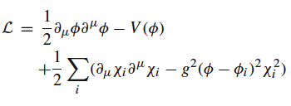

Axion Monodromy like potentials
NEM, Universe 7 (2021) 12, 480,
e-Print: 2111.05675 [hep-th]
Anomaly condensate → linear axion potential
Recall: approximately de Sitter provided during the duration of inflation
order of magnitude
< 0
N=e-folds
beginning
of inflation
Ooguri, Vafa, ...Palti
Distance-swampland
conjectures?
Potential ways out:
Jin, Brandenberger,
Heisenberg,
Eur. Phys. J. C (2021)
81:162
{
Trapped inflation scenarios
(moduli production @
enhanced symmetry points)

Slide 106
Axion Monodromy like potentials
NEM, Universe 7 (2021) 12, 480,
e-Print: 2111.05675 [hep-th]
BUT....
Anomaly condensate → linear axion potential =
Distance-swampland
conjectures avoided ?

Slide 107

Gravitational Anomaly Condensates → Dynamical Inflation
`
Basilakos, NEM, Sola
Positive
Cosmological
Constant-like
e-foldings
Positive total energy density since Λ-term dominates

Slide 108
Gravitational Anomaly Condensates → Dynamical Inflation
`
Basilakos, NEM, Sola
Positive
Cosmological
Constant-like
Positive total energy density since Λ-term dominates
Dark Energy
(``running
vacuum model
(RVM) type’’)

Slide 109
Gravitational Anomaly Condensates → Dynamical Inflation
`
NEM, Sola
Positive
Cosmological
Constant-like
Positive total energy density since Λ-term dominates
Dark Energy
(``running
vacuum model
(RVM) type’’)
Equation of state :
0 > ρ_{b} + ρ_{gCS} = - (p_{b} + p_{gCS} ) cf. phantom ``matter’’
0 < ρ_{Λ} = -p_{Λ} → dominates →
0 < ρ_{b} + ρ_{gCS} + ρ_{Λ} = - (p_{b} + p_{gCS} + p_{Λ}) true RVM
vacuum

Slide 110
Gravitational Anomaly Condensates → Dynamical Inflation
`
NEM, Sola
Phantom
matter
Positive
Cosmological
Constant-like
uintessence
hantom
energy
Dark Energy
(``running
vacuum model
(RVM) type’’)
Equation of state :
0 > ρ_{b} + ρ_{gCS} = - (p_{b} + p_{gCS} ) cf. phantom ``matter’’
0 < ρ_{Λ} = -p_{Λ} → dominates →
0 < ρ_{b} + ρ_{gCS} + ρ_{Λ} = - (p_{b} + p_{gCS} + p_{Λ}) true RVM
vacuum

Slide 111
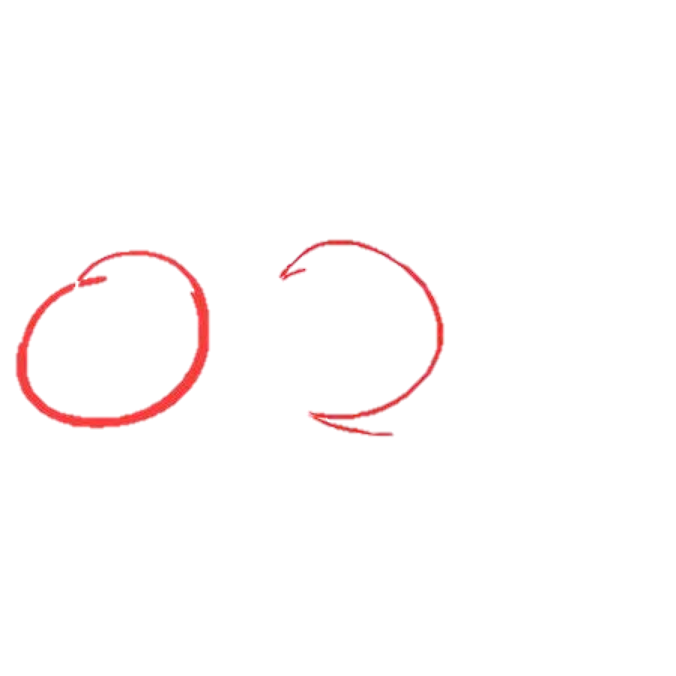

Gravitational Anomaly Condensates → Dynamical Inflation
`
Basilakos, NEM, Sola
Positive
Cosmological
Constant-like
Positive total energy density since Λ-term dominates
RVM-like terms
drive inflation
contain scalar d.o.f.
from the anomaly
condensate
Dark Energy
(``running
vacuum model
(RVM) type’’)
But slow roll is due to the KR axion field

Slide 112
Basilakos, Lima,
Sola + Gomez Valent
+ ... (2013 - 2018 )
Cosmological Evolution of RVM
m = matter, radiation
Solution
Early de Sitter
(unstable)
Radiation
Late dark-Energy
dominated era
c₀ dominant

Slide 113
Gravitational Anomaly Condensates → Dynamical Inflation
Cannot obtain such terms
in ordinary Quantum Field Theories
You need the condensate of
the gravitational anomalies
which have CP-violating couplings
with the gravitational axions
`
`
NEM, Sola
Positive total energy density since Λ-term dominates
Positive total energy density since Λ-term dominates
RVM-like terms
drive inflation
contain scalar d.o.f.
from the anomaly
condensate
Dark Energy
(``running
vacuum model
(RVM) type’’)
But slow roll is due to the KR axion field

Slide 114
Gravitational Anomaly Condensates → Dynamical Inflation
Cannot obtain such terms
in ordinary Quantum Field Theories
You need the condensate of
the gravitational anomalies
which have CP-violating couplings
with the gravitational axions
`
`
Another important
role of CP-violation
in Early Universe
Positive total energy density since Λ-term dominates
Positive total energy density since Λ-term dominates
RVM-like terms
drive inflation
contain scalar d.o.f.
from the anomaly
condensate
Dark Energy
(``running
vacuum model
(RVM) type’’)
But slow roll is due to the KR axion field

Slide 115
Gravitational Anomaly Condensates → Dynamical Inflation
`
Basilakos, NEM, Sola
Positive
Cosmological
Constant-like
Positive total energy density since Λ-term dominates
RVM-like terms
drive inflation
contain scalar d.o.f.
from the anomaly
condensate
Negative coefficient ν < 0
due to CS anomaly
in early Universe, unlike
late-era RVM
But slow roll is due to the KR axion field

Slide 116
Solutions (backgrounds) to the Eqs of Motion
Undiluted KR axion background
at the end of Inflation
@ end of
Inflationary
era

Slide 117
Solutions (backgrounds) to the Eqs of Motion
Undiluted KR axion background
at the end of Inflation
@ end of
Inflationary
era
Important for Leptogenesis @ radiation era

Slide 118
6. Enhanced cosmic perturbations
and densities of primordial black holes and Gravitational Waves

Slide 119


World-Sheet Instantons, Axion Monodromy like potentials
& deviations from scale invariance
NEM, Universe 7 (2021) 12, 480,
e-Print: 2111.05675 [hep-th]
Anomaly condensate → linear axion potential
Such a potential can also arise in appropriate brane compactifications
(eg type IIB strings)
L. McAllister, E. Silverstein and A. Westphal,
Phys. Rev. D 82 (2010), 046003
[arXiv:0808.0706 [hep-th]].
We may extend the model to include other stringy axions arising from compactification
f_{a} = axion coupling
canonical kinetic
terms for a-axions

Slide 120






World-Sheet Instantons, Axion Monodromy like potentials
& deviations from scale invariance
NEM, Universe 7 (2021) 12, 480,
e-Print: 2111.05675 [hep-th]
NEM, Spanos, Stamou,
hep-th-2206.07963
Anomaly condensate → linear axion potential
world-sheet (non-perturbative) instantons → periodic potential perturbations
→
Restrict to
NB: For S_{winst} $≥$ O(40): m_{a} $≤$O(10⁻¹⁷) eV, still compatible with ultralight axion DM
warp factor
L. McAllister, E. Silverstein and A. Westphal,
Phys. Rev. D 82 (2010), 046003
[arXiv:0808.0706 [hep-th]].

Slide 121


World-Sheet Instantons, Axion Monodromy like potentials
& deviations from scale invariance
Anomaly condensate → linear axion potential
world-sheet (non-perturbative) instantons → periodic potential perturbations
NEM, Sola + Basilakos
NEM, Spanos, Stamou,
hep-th-2206.07963
Case I
Case II
Zhou, Jiang, Cai, Sasaki, Pi,
Phys. Rev. D 102 (2020) no.10, 103527

Slide 122
World-Sheet Instantons, Axion Monodromy like potentials
& deviations from scale invariance
Anomaly condensate → linear axion potential
world-sheet (non-perturbative) instantons → periodic potential perturbations
NEM, Sola + Basilakos
NEM, Spanos, Stamou,
hep-th-2206.07963
Case I
Case II
Enhancement of cosmic perturbations
Zhou, Jiang, Cai, Sasaki, Pi,
Phys. Rev. D 102 (2020) no.10, 103527

Slide 123
World-Sheet Instantons, Axion Monodromy like potentials
& deviations from scale invariance
Anomaly condensate → linear axion potential
world-sheet (non-perturbative) instantons → periodic potential perturbations
NEM, Spanos, Stamou,
hep-th-2206.07963
Case I

Slide 124
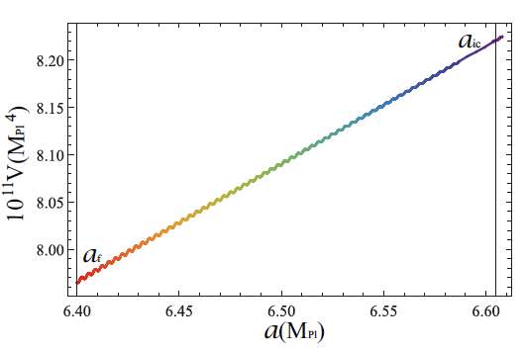
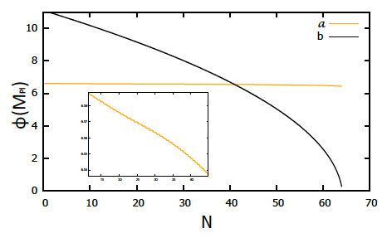



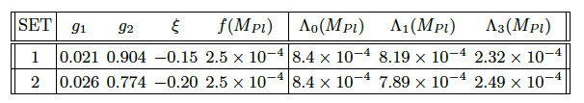
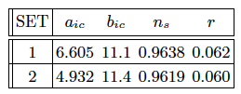
The enhancement of cosmic perturbations mechanism
NEM, Spanos, Stamou,
hep-th-2206.07963
b-field + condensate drive inflation, a-axion ends inflation
``step-like’’
features
{sec:pbhgw}

Slide 125
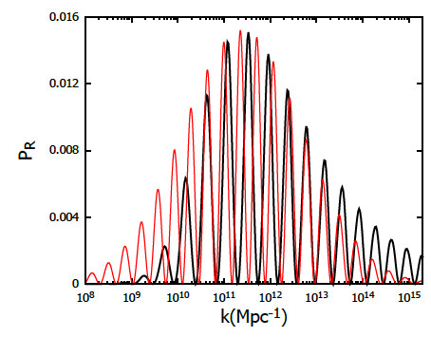


The enhancement of cosmic perturbations mechanism
NEM, Spanos, Stamou,
hep-th-2206.07963
b-field + condensate drive inflation, a-axion ends inflation
Parameters
SET 1
ω_{log} $≥$ ω_{c} resonant peak in Ω_{GW}
Fumagalli, Renaux-Petel, Witkowski,
arXiv: 2105.04861

Slide 126
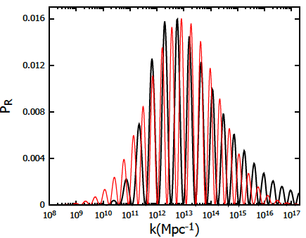
The enhancement of cosmic perturbations mechanism
NEM, Spanos, Stamou,
hep-th-2206.07963
b-field + condensate drive inflation, a-axion ends inflation
Parameters
SET 2
ω_{log} $≥$ ω_{c} resonant peak in Ω_{GW}
Fumagalli, Renaux-Petel, Witkowski,
arXiv: 2105.04861

Slide 127

The enhancement of cosmic perturbations mechanism
NEM, Spanos, Stamou,
hep-th-2206.07963
b-field + condensate drive inflation, a-axion ends inflation
Parameters
SET 2
SET 1
ω_{log} $≥$ ω_{c} resonant peak in Ω_{GW}
Fumagalli, Renaux-Petel, Witkowski,
arXiv: 2105.04861

Slide 128
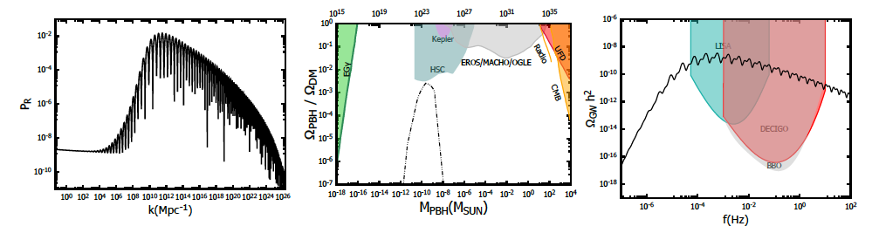

Primordial Black Hole (PBH) and GW
enhanced production during inflation
NEM, Spanos, Stamou,
hep-th-2206.07963
SET 1
fractional PBH abundance
k

Slide 129
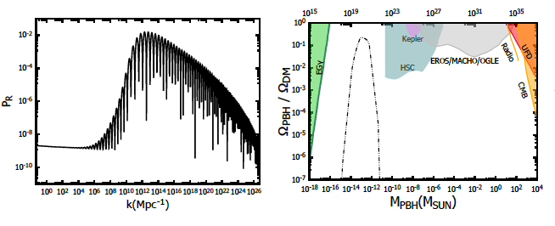
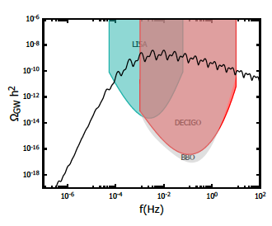
Primordial Black Hole (PBH) and GW
enhanced production during inflation
NEM, Spanos, Stamou,
hep-th-2206.07963
SET 2
fractional PBH abundance
k

Slide 130
World-Sheet Instantons, Axion Monodromy like potentials
& deviations from scale invariance
Anomaly condensate → linear axion potential
world-sheet (non-perturbative) instantons → periodic potential perturbations
Case II
Zhou, Jiang, Cai, Sasaki, Pi,
Phys. Rev. D 102 (2020) no.10, 103527
NEM, Spanos, Stamou,
hep-th-2206.07963

Slide 131
World-Sheet Instantons, Axion Monodromy like potentials
& deviations from scale invariance
Anomaly condensate → linear axion potential
world-sheet (non-perturbative) instantons → periodic potential perturbations
NEM, Spanos, Stamou,
hep-th-2206.07963
Case II
specific set of parameters
enhancement due to inflection
points in the potential →
different enhancement mechanism
than in
Zhou, Jiang, Cai, Sasaki, Pi,
Phys. Rev. D 102 (2020) no.10, 103527

Slide 132
World-Sheet Instantons, Axion Monodromy like potentials
& deviations from scale invariance
Anomaly condensate → linear axion potential
world-sheet (non-perturbative) instantons → periodic potential perturbations
SET 3
Case II
NEM, Spanos, Stamou,
hep-th-2206.07963
specific set of parameters
enhancement due to inflection
points in the potential →
different enhancement mechanism
than in
Zhou, Jiang, Cai, Sasaki, Pi,
Phys. Rev. D 102 (2020) no.10, 103527

Slide 133
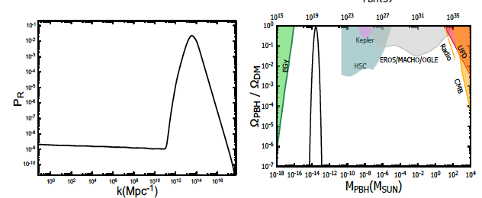
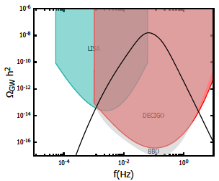
Primordial Black Hole (PBH) and GW
enhanced production during inflation in Case 2
NEM, Spanos, Stamou,
hep-th-2206.07963.
SET 3
fractional PBH abundance
k
0.762

Slide 134
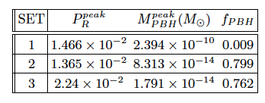
SUMMARY: Primordial Black Hole (PBH) and GW
enhanced production during inflation in Cases 1 + 2
NEM, Spanos, Stamou,
hep-th-2206.07963
Hence in both hierarchies of scales :
Case 1: , Case 2:
Common: one may get significant enhancement of cosmic perturbations,
ands PBH production, and thus a significant portion of PBH could
play the role of DM, also, as a result, profiles of GW could change during radiation.
Difference: In case 1: intensely oscillating spectra , case 2: smooth behaviour
distrinct behaviour, in principle falsifiable predictions at future interferometers
(e.g. LISA).

Slide 135
7. Post Inflationary Eras
&
Cosmic Evolution
of the stringy RVM

Slide 136
Post-RVM-Inflation Eras & Evolution
`
NEM,Sola
EPJ-ST (2020)
KR axion
dominance
GW + Anomalies
dominance
?

Slide 137
Cancellation of Gravitational Anomalies in Radiation Era
by:
Chiral Fermionic Matter generation @ end of Inflation
`
Basilakos, NEM,Sola (2019-20)
Required by consistency of quantum theory
of matter and radiation (diffeomorphism invariance)
`
NEM,Sola
EPJ-ST (2020)
KR axion
dominance
Chiral matter
Generation + cancellation
of grav. Anomalies
Leptogenesis → Baryogenesis
(LV + CPTV KR axion backgrounds)
GW + Anomalies
dominance
NEM, Sarkar
+ De Cesare, Bossingham
Chiral anomalies
Remain in matter era
KR axion mass generation through
QCD instantons (Dark Matter)

Slide 138
Cancellation of Gravitational Anomalies in Radiation Era
by:
Chiral Fermionic Matter generation @ end of Inflation
`
Basilakos, NEM,Sola (2019-20)
Required by consistency of quantum theory
of matter and radiation (diffeomorphism invariance)
`
NEM,Sola
EPJ-ST (2020)
KR axion
dominance
Chiral matter
Generation + cancellation
of grav. Anomalies
Leptogenesis → Baryogenesis
(LV + CPTV KR axion backgrounds)
GW + Anomalies
dominance
NEM, Sarkar
+ De Cesare, Bossingham
Chiral anomalies
Remain in matter era
KR axion mass generation through
QCD instantons (Dark Matter)

Slide 139
The Whole
Stringy-RVM
Cosmological
Evolution

Slide 140
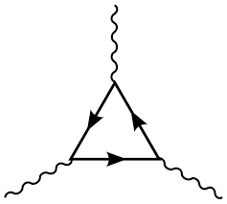



Summary of (stringy-RVM) Cosmological Evolution
Cosmic
Time
`
Big-Bang, pre-inflationary phase (broken Sugra)
Basilakos, NEM, Sola
Undiluted constant
KR axial backround
chiral matter
generation
@ inflation exit
RVM Inflationary (de Sitter) Phase
Primordial
Gravitational
Waves
Gravitational
anomaly (GA)
From a pre-inflationary
era after Big-Bang
Radiation Era
forward direction
Cancellation of GA
Leptogenesis induced by
RHN (tree-level) decays
B-L conserving sphelaron processes → Baryongenesis
Matter Era
Possible potential (mass) generation for b → axion Dark matter
Modern de-Sitter Era
GA resurfacing
Phenomenology

Slide 141

Summary of (stringy-RVM) Cosmological Evolution
Cosmic
Time
`
Big-Bang, pre-inflationary phase (broken Sugra)
Basilakos, NEM, Sola
Undiluted constant
KR axial backround
chiral matter
generation
@ inflation exit
RVM Inflationary (de Sitter) Phase
Primordial
Gravitational
Waves
Gravitational
anomaly (GA)
Radiation Era
forward direction
Cancellation of GA
Leptogenesis induced by
RHN (tree-level) decays
Consistent with current
bounds on LV & CPTV
B₀ < 10⁻² eV,
B_{i} < 10⁻²² eV
Need to understand
Modern Era better
B-L conserving sphelaron processes → Baryongenesis
Matter Era
Possible potential generation for b – → axion Dark matter
H₀ ~ 10⁻⁴² GeV
≈ 10⁻⁶⁰ M_{Pl}≈ 10⁻³³ eV
Modern de-Sitter Era
GA resurfacing
Phenomenology

Slide 142


Summary of (stringy-RVM) Cosmological Evolution
Cosmic
Time
`
Big-Bang, pre-inflationary phase (broken Sugra)
Basilakos, NEM, Sola
Undiluted constant
KR axial backround
chiral matter
generation
@ inflation exit
RVM Inflationary (de Sitter) Phase
Primordial
Gravitational
Waves
Gravitational
anomaly (GA)
Distinguishing feature from ΛCDM
Alleviate data tensions
Radiation Era
)
forward direction
today
0
Cancellation of GA
0
Leptogenesis induced by
RHN (tree-level) decays
0 <
0
B-L conserving sphelaron processes → Baryongenesis
today
Gómez-Valent
Solà
Matter Era
0
Possible potential generation for b → axion Dark matter
today
0
Modern de-Sitter Era
GA resurfacing
RVM-type
Running Dark Energy

Slide 143
Solà, Gómez-Valent,
De Cruz Perez, Moreno-Pulido,
(Planck 2018 data)
If tensions
are not due
to statistics
Alleviation of the H₀ , σ₈ tension by RVM model

Slide 144
NEM, Solà (2021)
Integrating out graviton flcts
Alleviation of the S₈ , σ₈ tension by RVM model
+ Λ
Almost-Type II RVM
in our stringy RVM
due to quantum-gravity
Corrections

Slide 145
8. Conclusions
&
Outlook

Slide 146
The Basic ``Cosmic Cycle’’
Deviations from ΛCDM
Resolution of tensions ?
Dark Energy
(``running
vacuum model
(RVM) type’’)
Gravitational
anomalies
Stringy
gravitational
Axions
+
torsion
KR axion
Mass
current
epoch
Primordial
gravitational
waves
Dark Matter
geometric
origin
Lorentz-
Violating
Leptogenesis
&
matter-
antimatter
Asymmetry
Spontaneous
Lorentz + CPT
Violation
from
anomaly
condensates
Dynamical
Inflation
Of RVM type
without
external
inflatons

Slide 147
Deviations from ΛCDM
Resolution of tensions ?
The Parts/the Whole
Dark Energy
(``running
vacuum model
(RVM) type’’)
Gravitational
anomalies
Stringy
gravitational
Axions
+
torsion
KR axion
Mass
current
epoch
Primordial
gravitational
waves
Stringy RVM
Dark Matter
geometric
origin
Lorentz-
Violating
Leptogenesis
&
matter-
antimatter
Asymmetry
Spontaneous
Lorentz + CPT
Violation
from
anomaly
condensates
Dynamical
Inflation
Of RVM type
without
external
inflatons

Slide 148


References:
Basilakos, NEM, Solà
(i)JCAP 12 (2019) 025
(ii) IJMD28 (2019) 1944002
(iii) Phys.Rev.D 101 (2020) 045001
(iv) Phys.Lett.B 803 (2020) 135342
(v) Universe 2020, 6(11), 218
NEM, Solà
(vi) EPJST 230 (2020), 2077
(vii) EPJPlus 136 (2021), 1152
NEM
(viii) arXiv:2205.07044
(ix) Universe 7 (2021), 480
Phil. Trans. A380 (2022) 2222
NEM, Spanos, Stamou,
(xi) hep-th:2206.07963
Thank you!
a microscopic
(string-inspired)
model for
RVM Universe....
Links with :
spontaneous Lorentz violation
(via (gravitational axion) backgrounds)
and
Matter-Antimatter Asymmetry
in theories with
Right-Handed Neutrinos
(i) NEM & Sarben Sarkar, EPJC 73
(2013), 2359
(ii) John Ellis, NEM & Sarkar, PLB 725
(2013), 407
(iii) De Cesare, NEM & Sarkar, EPJC 75
(2015), 514
(iv) Bossingham, NEM & Sarkar,
EPJC 78 (2018), 113; 79 (2019), 50
(v) NEM & Sarben Sarkar, EPJC 80
(2020), 558

